Slide 1
SAP BTP Extension Suite Training
Day 15
Anubhav Oberoy
www.AnubhavTrainings.com
Follow excellence with sheer passion

Slide 2


DISCLAIMER
The training content and delivery of this presentation is confidential, and cannot be recorded, or copied and distributed to any third party, without the written consent of Anubhav Trainings

Slide 3
Agenda – Day 15
01
Testing S/4HANA API
02
Create first CAP project for extension
03
Consume and Test Business API for extension project

Slide 4
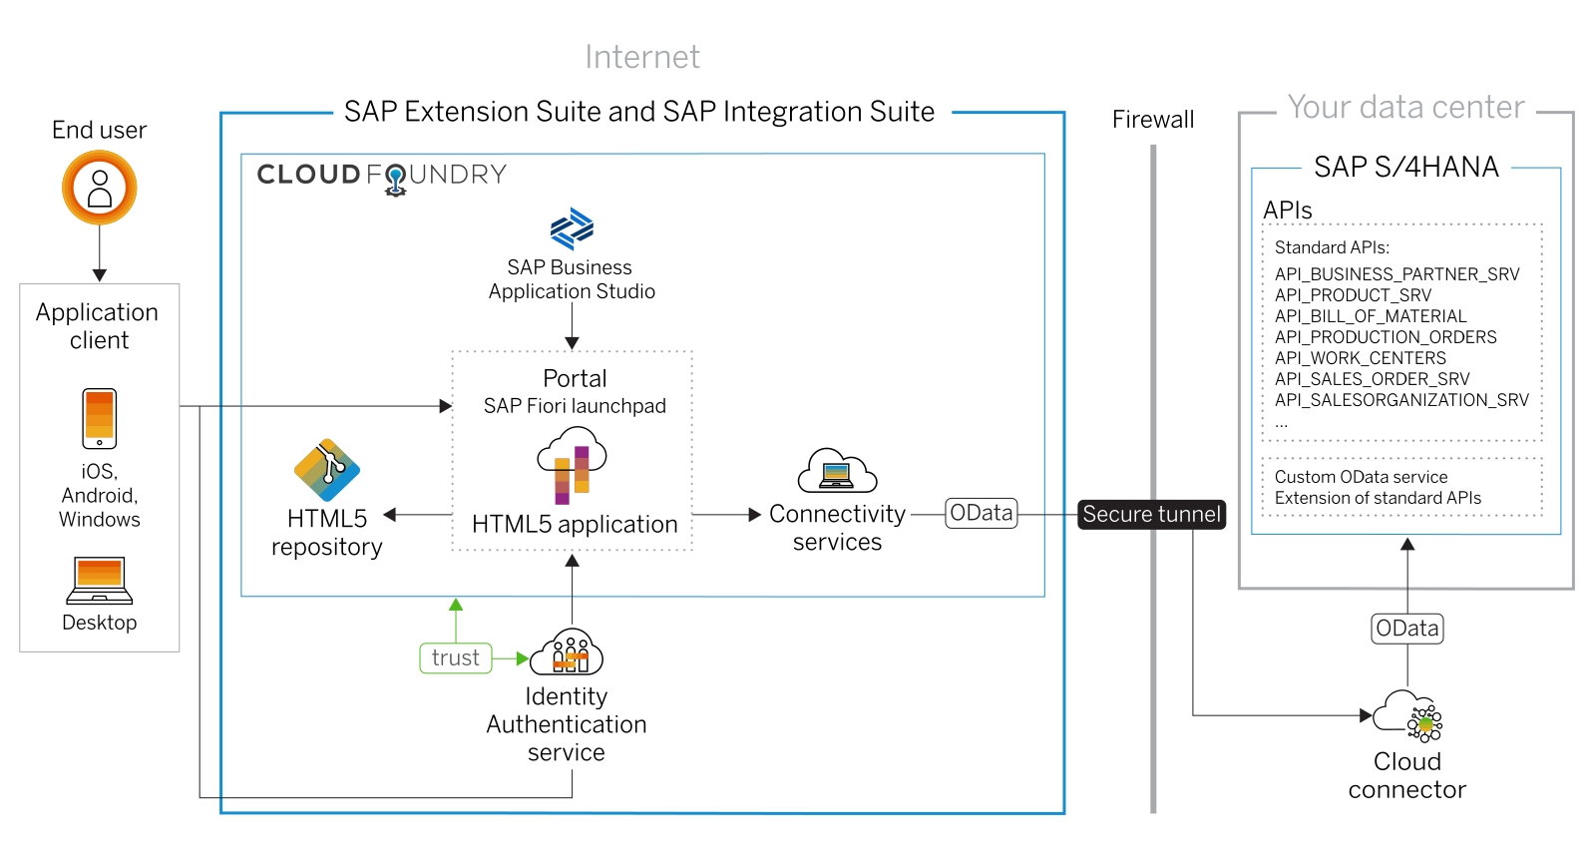
Scenario 1: UI Extensibility

Slide 5
Scenario 2:
Own Fiori App
SAP or Non SAP API OData which we want to reuse
Android App
SAP UI5 App
CAPM App
Middleware
Data manipulation, enrichment, Security, automation, movement, proxy
HANA

Slide 6
Hands on: Initialize CAPM Extension
Create a new cap project with cds init
Install the node module @sap-cloud-sdk/generator and @sap-cloud-sdk/odata-v2 as dev dependencies
Drag drop edmx file downloaded from API hub and perform TRANSPILE is VERY IMPORANT
npx generate-odata-client --transpile --input resources/service-specs --outputDir src/generated
Copy src folder inside srv so packaging can be done
Create a new folder service-spec, and cds watch, after that drag drop the edmx file of our service to the folder. It will create external folder
Add a new CatalogService.cds and CatalogService.js
S4HANA cloud sdk is SAP’s portfolio of all the type safe API (node modules) to communicate to SAP APIs.
Code - https://github.com/soyuztechnologies/BTP_Architect_CLD200/tree/master/Day%2015/s4hanaextensions
Add the configuration to test our api locally – credentials
cf create-service xsuaa application myxsuaa
cf create-service-key myxsuaa myxsuaa-key
cds bind --to myxsuaa:myxsuaa-key cds run --profile hybrid
Repeat the same steps for the destination service

Slide 7
@sap-cloud-sdk/generator
To generate code to call business API automatically from CAP to S/4HANA
JS code to call the API
Edmx file

Slide 8
GUI
S/4HANA OP
odata
cds
IRPA
Build Automation
CaI
Data intelligence
SAP Analytics Cloud
API
Browser
S/4HANA Cloud
In-app extension

Slide 11

What We Did
Let’s Summarize

Slide 12

www.anubhavtrainings.com
Thank You
End of Day 6

Slide 13


We’re committed to empower you to be
#FutureReady
through powerful training solutions.
We build the workforce of the future.
260+
Corporate Clients
60,000+
Learners Trained
26000+
Learners Placed
FREE WEBINARS
Sign up for free webinars with industry experts every fortnight!
Enroll Now!
Contact us today!
https://anubhavtrainings.com

